Slide 1
Unit 2
Ontology and their Role in the Semantic Web

Slide 2
Roles of Ontology in the Semantic Web
Introduction
The Semantic Web is an extension of the current web, where information is given well-defined meaning.
Ontologies form the backbone of the Semantic Web by providing structured vocabularies and shared understanding.
They help machines interpret, integrate, and reason over heterogeneous web data.

Slide 3
Definition of Ontology
In computer science:
“An ontology is a formal, explicit specification of a shared conceptualization.”
It defines:
Concepts (Classes)
Relationships (Properties)
Instances (Individuals)
Constraints and Axioms

Slide 4
Roles of Ontology in Semantic Web
Knowledge Representation
Provides standardized representation of concepts and their relationships.
Helps computers understand domain-specific terms.
Example: "Doctor treats Patient" in healthcare ontology.
3.2 Semantic Interoperability
Enables data exchange between heterogeneous systems.
Bridges the gap between different vocabularies used across applications.
Example: “Car” in one dataset = “Automobile” in another.
Information Integration
Facilitates merging of information from multiple sources.
Example: Combining weather data (temperature, humidity) from different APIs.

Slide 5
Roles of Ontology in Semantic Web(Cont.,)
Knowledge Sharing & Reuse
Provides a shared vocabulary for communication.
Ontologies can be reused across applications (e.g., FOAF for people, Dublin Core for metadata).
Reasoning and Inference
Enables automated reasoning using logic-based rules.
Helps derive new facts from existing data.
Example: If “All mammals are warm-blooded” and “Dolphin is a mammal” → infer “Dolphin is warm-blooded.”
Improved Information Retrieval
Enhances search engines by retrieving semantically relevant results.
Example: Searching for “heart specialist” also finds results about “cardiologist.”
Data Annotation
Ontologies provide a framework for annotating web content.
Example: Tagging a webpage with ontology-based metadata (RDF/OWL).

Slide 6
Ontology Languages in Semantic Web
RDF (Resource Description Framework) – Basic data representation.
RDFS (RDF Schema) – Vocabulary description.
OWL (Web Ontology Language) – Rich ontology modeling and reasoning.
SPARQL – Query language for semantic data.

Slide 7
Applications of Ontologies in Semantic Web
Healthcare: Clinical decision support using medical ontologies (SNOMED, UMLS).
E-commerce: Product categorization and recommendation.
Education: Semantic learning systems.
Search Engines: Google Knowledge Graph, Bing Semantic Search.
Social Networks: FOAF ontology for relationships.

Slide 8
Challenges in Using Ontologies
Complexity in designing ontologies.
Alignment and merging of multiple ontologies.
Scalability for large-scale web applications.
Keeping ontologies updated with evolving knowledge.

Slide 9
Ontology-Based Knowledge Representation
Introduction
Knowledge Representation (KR): A field in AI that deals with representing information about the world in a form that a computer system can use to solve complex tasks.
Ontology-Based KR: Uses ontologies as a structured, formalized method of representing knowledge.
It goes beyond simple data storage by providing semantics (meaning).

Slide 10
What is Ontology in KR?
An ontology defines:
  Concepts (Classes): Abstract groups or categories (e.g., Person, Disease, Car).
  Instances (Individuals): Actual examples of classes (e.g., "Rajesh is a Person").
  Properties (Relations): Associations between concepts (e.g., Person drives Car).
  Axioms & Constraints: Logical rules (e.g., "All doctors are persons").
Ontologies serve as shared vocabularies to ensure consistent meaning across applications.

Slide 11
Characteristics of Ontology-Based KR
Formal – Based on logic and machine-processable.
Explicit – All concepts and relationships are clearly defined.
Shared – Provides common understanding across systems/users.
Semantic-rich – Supports reasoning and inference.

Slide 12
Role of Ontology in Knowledge Representation
Standardized Representation
Provides a common framework for defining domain knowledge.
Semantic Interoperability
Enables different systems to communicate using shared semantics.
Reasoning & Inference
Supports logical reasoning to infer new knowledge.
Example:
  Rule: "If X is a parent of Y, and Y is a parent of Z → X is a grandparent of Z."
  Ontology allows automated reasoning to derive this fact.
Reusability & Modularity
Ontologies can be reused across applications (e.g., medical ontology in multiple healthcare systems).
Enhanced Information Retrieval
Search engines can retrieve semantically relevant information

Slide 13
Ontology Representation Languages
RDF (Resource Description Framework) – Data representation using triples (subject–predicate–object).
RDFS (RDF Schema) – Adds hierarchy and constraints.
OWL (Web Ontology Language) – Rich logic-based representation, supports reasoning.
SPARQL – Query language for RDF data.

Slide 14
Examples of Ontology-Based KR
Healthcare: Ontology for diseases, symptoms, and treatments (SNOMED CT).
E-commerce: Ontology for product categories, customer preferences.
Education: Learning object ontology for personalized learning.
Semantic Web: Google Knowledge Graph uses ontology principles.

Slide 15
Advantages
Facilitates automation in reasoning.
Reduces ambiguity in data interpretation.
Enables integration of heterogeneous data sources.
Provides machine-understandable semantics.

Slide 16
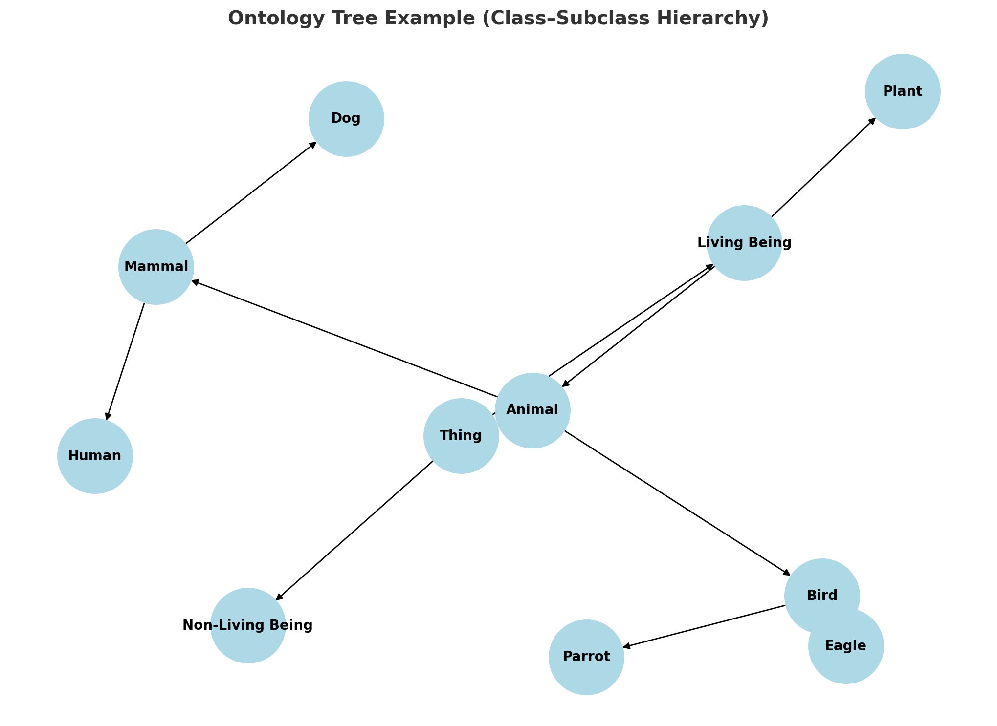
Explanation:
Root Node: Thing (represents everything that exists).
First Level: Split into Living Being and Non-Living Being.
Living Being → Animal, Plant
Animal → Mammal, Bird
Mammal → Human, Dog
Bird → Parrot, Eagle
This hierarchy shows how general concepts (Thing, Living Being, Animal) break down into specific subclasses (Human, Dog, Parrot, Eagle).
💡 In ontology-based knowledge representation:
Each subclass inherits properties from its parent.
Example: If Animal has the property “needs oxygen”, then both Mammal and Bird (and their subclasses like Human, Dog, Parrot, Eagle) inherit this property automatically.

Slide 17
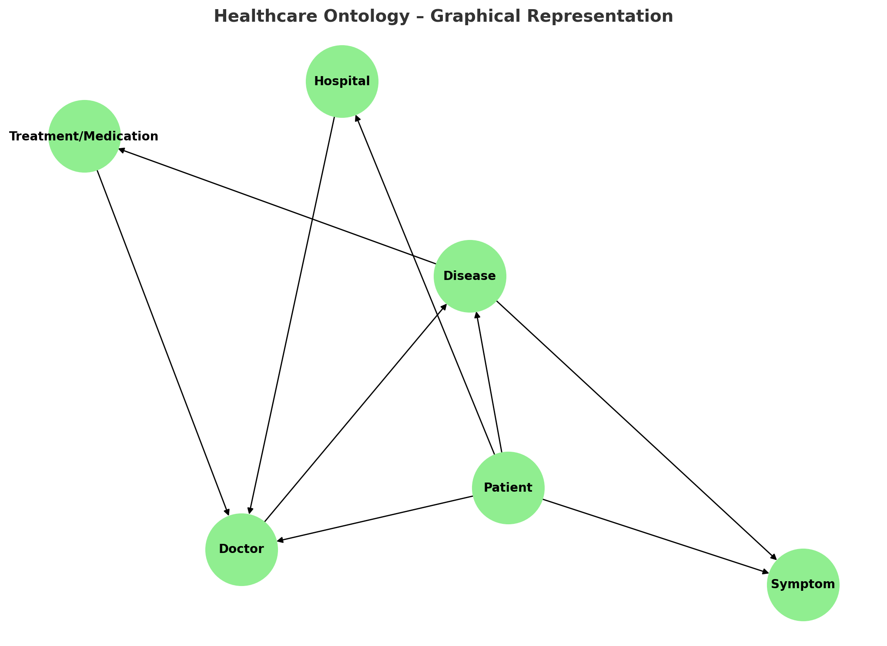
Explanation of Relationships:
Patient → Symptom: Patients exhibit symptoms (e.g., fever, cough).
Patient → Disease: Patients are diagnosed with diseases.
Disease → Symptom: Diseases are characterized by certain symptoms.
Disease → Treatment/Medication: Each disease has associated treatments (e.g., diabetes → insulin).
Patient → Doctor: Doctors are responsible for diagnosing and treating patients.
Doctor → Disease: Doctors specialize in and manage specific diseases.
Hospital → Doctor: Hospitals employ or host doctors.
Patient → Hospital: Patients receive care in hospitals.
Treatment/Medication → Doctor: Doctors prescribe treatments.

Slide 18
Ontology Languages: RDF and OWL
Introduction
Ontology languages are formal languages used to define, represent, and share knowledge on the Semantic Web.
They allow machines to understand relationships between data and perform reasoning.
The two core ontology languages are RDF (Resource Description Framework) and OWL (Web Ontology Language).

Slide 19
Ontology Languages: RDF and OWL(Cont.,)
RDF (Resource Description Framework)
Definition
W3C standard for describing resources on the web.
Represents knowledge as triples:
  Subject – Predicate – Object

Slide 20
Ontology Languages: RDF and OWL(Cont.,)
Example:
:Patient123 :hasDisease :Diabetes
Meaning: Patient123 has the disease Diabetes.
Features
  Simple, flexible model for representing relationships.
  Provides a graph-based data model.
  Foundation for other Semantic Web languages.🔹
RDF Schema (RDFS)
  Extension of RDF.
  Provides vocabulary for classes, properties, and hierarchies.
  Example:
    :Doctor rdfs:subClassOf :Person

Slide 21
Challenges
High complexity in building and maintaining ontologies.
Difficulties in aligning multiple ontologies.
Scalability issues with large datasets.
Need for domain expertise.

Slide 22
OWL (Web Ontology Language)
Definition
A more expressive ontology language built on RDF/RDFS.
Enables reasoning, constraints, and richer semantics.
Features
Allows definition of classes, properties, individuals, and axioms.
Supports class hierarchies, equivalence, disjointness, and restrictions.
Provides logical reasoning capabilities.

Slide 23
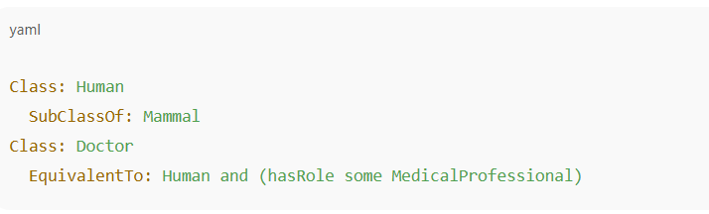
Example:
OWL Species
OWL Lite – Simple, lightweight ontologies.
OWL DL – Description Logic-based, balances expressiveness and decidability.
OWL Full – Most expressive but undecidable.

Slide 24
Comparison: RDF vs OWL
Aspect | RDF / RDFS | OWL (Web Ontology Language)
Purpose | Basic data representation | Rich semantic representation
Model | Subject–Predicate–Object triples | Classes, properties, restrictions
Reasoning | Limited (simple hierarchy) | Advanced logical reasoning
Expressiveness | Low | High (can define complex ontologies)
Use Case | Metadata, linked data | Ontology modeling, AI reasoning

Slide 25
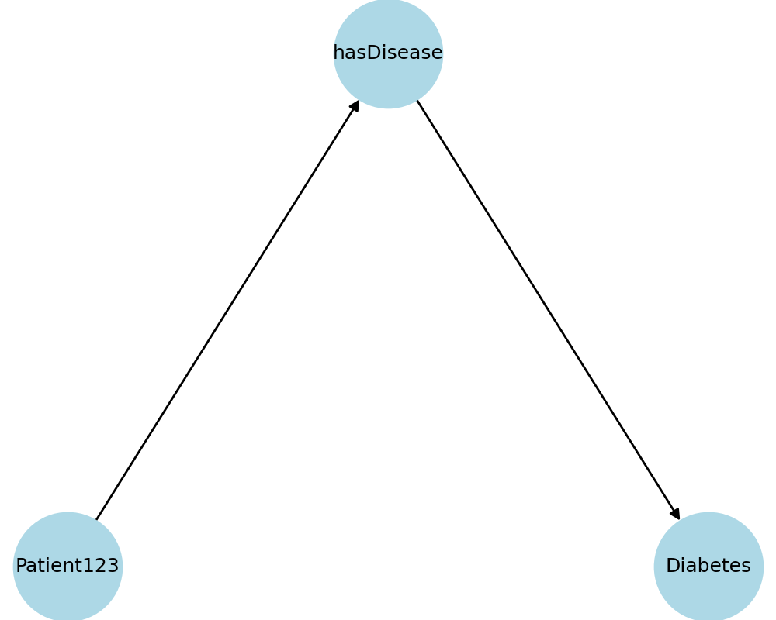
RDF Triple Graph (Subject–Predicate–Object)
RDF represents data as triples:
• Subject: Patient123
• Predicate: hasDisease
• Object: Diabetes
This allows data to be connected in a graph-based structure.

Slide 26
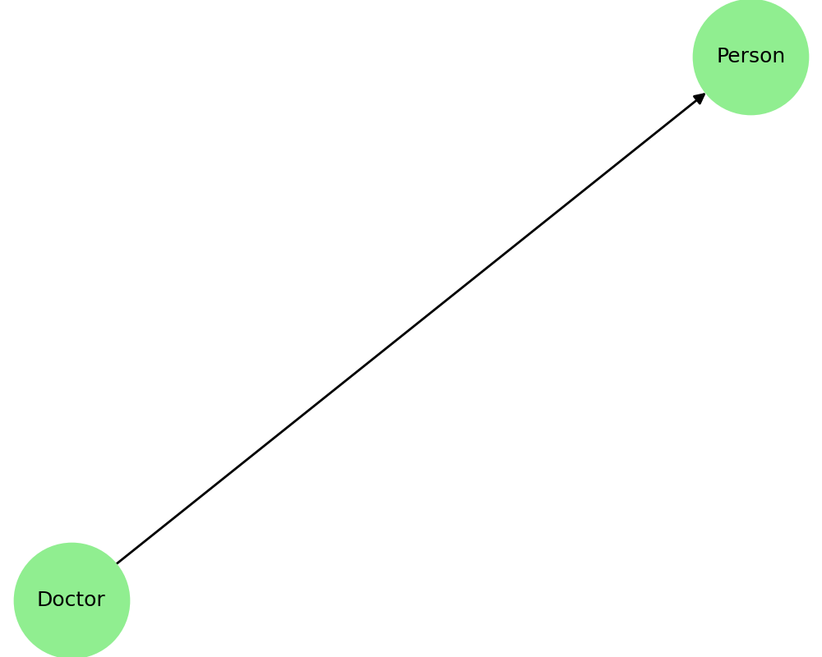
RDF Schema Hierarchy (Doctor subclass of Person)
RDF Schema (RDFS) adds hierarchy:
• Example: Doctor rdfs:subClassOf Person
• Meaning: Every Doctor is also a Person.
This supports inheritance of properties.

Slide 27
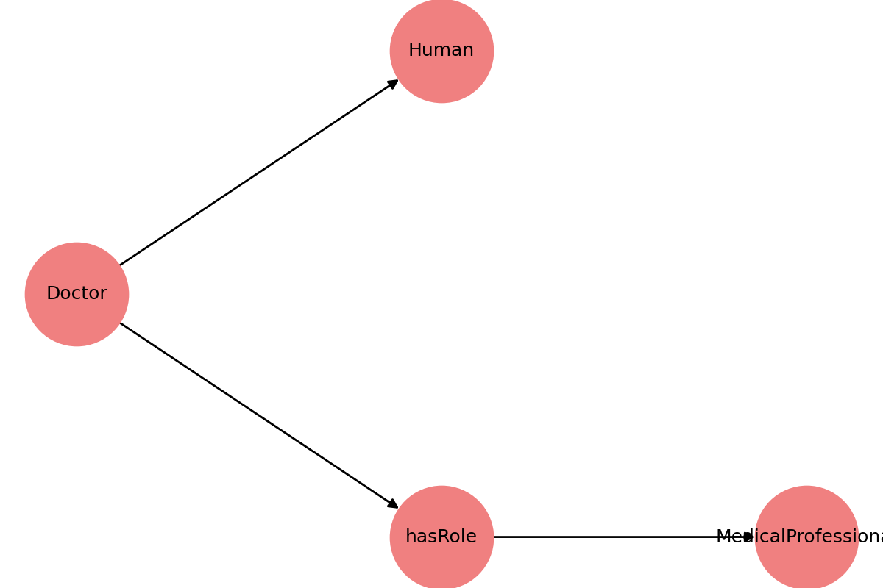
OWL Reasoning Example (Doctor ≡ Human ∧ hasRole MedicalProfessional)
OWL allows reasoning with axioms:
• Doctor ≡ Human ∧ hasRole MedicalProfessional
• Meaning: A Doctor is a Human with the role of MedicalProfessional.
OWL enables logical inference in ontologies.

Slide 28
Introduction to Resource Description Framework (RDF)
What is RDF?
RDF (Resource Description Framework) is a W3C standard for representing information about resources on the Web.
It provides a graph-based model that describes relationships between resources in the form of triples.
Goal: Make data machine-readable and enable interoperability.

Slide 29
RDF Data Model
RDF expresses data as triples:
  Subject – the resource being described
  Predicate – the property/relationship
  Object – the value or another resource
:Patient123 :hasDisease :Diabetes
Subject = Patient123
Predicate = hasDisease
Object = Diabetes
Represented as a graph: Patient123 → hasDisease → Diabetes

Slide 30
Key Concepts in RDF
Resource – Anything that can be identified (people, places, documents, concepts).
URI (Uniform Resource Identifier) – Unique identifier for resources.
Literal – Data values (e.g., strings, numbers, dates).
Blank Node – Represents resources without a URI (anonymous nodes).

Slide 31
Advantages of RDF
Provides interoperability across systems.
Enables data linking across domains (Linked Data).
Supports semantic search and integration.
Foundation for higher-level ontology languages (like OWL).
Applications of RDF
Linked Data (DBpedia, Wikidata).
Metadata description for digital libraries.
Semantic Web search engines (Google Knowledge Graph).
Healthcare systems for interoperability of patient data.

Slide 32
Web Ontology Language (OWL): Features & Examples
Introduction
OWL (Web Ontology Language) is a W3C standard ontology language used in the Semantic Web.
Built on top of RDF and RDFS, OWL adds more expressiveness and reasoning capabilities.
It is designed to represent rich and complex knowledge about things, groups of things, and relations between them.

Slide 33
Why OWL?
RDF/RDFS are limited to basic hierarchies.
OWL allows:
Defining equivalent classes
Declaring disjoint classes
Adding restrictions on properties
Performing reasoning to infer new knowledge

Slide 34
Features of OWL
Class Hierarchies
  Supports subclass–superclass relationships.
  Example: Doctor ⊆ Person
Equivalence & Disjointness
  Classes can be declared equivalent (same meaning) or disjoint (mutually exclusive).
  Example: Man ⊓ Woman = ⊥ (disjoint)
Property Characteristics
  Properties can be functional, transitive, symmetric, inverse.
  Example: hasParent is inverse of hasChild.
Restrictions
  Define constraints on class membership.
  Example: Person ⊓ (hasAge ≥ 18) → Adult.
Reasoning
  Enables logical inference.
  Example: If Doctor ⊆ Human and Rajesh is a Doctor, we infer Rajesh is a Human.
Individuals (Instances)
  Real-world entities can be defined as instances of classes.

Slide 35
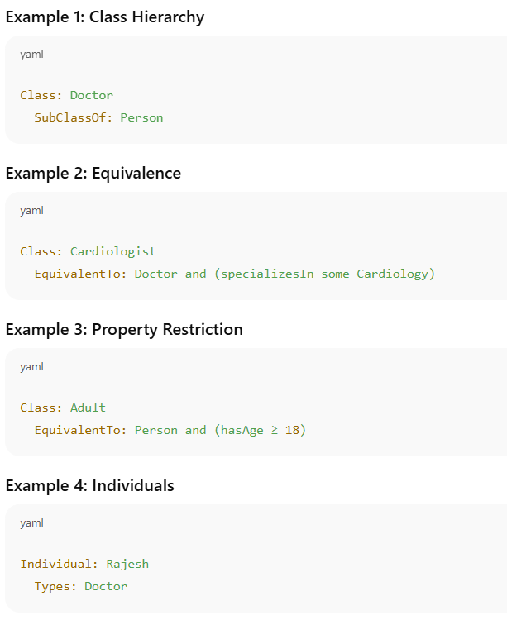
Examples of OWL Statements

Slide 36
Applications of OWL
Healthcare: Disease–Symptom–Treatment modeling (SNOMED CT).
E-commerce: Product classification & recommendations.
Knowledge Graphs: Google Knowledge Graph, DBpedia, Wikidata.
Education: Smart learning systems.
AI & NLP: Semantic reasoning for intelligent agents.

Slide 37

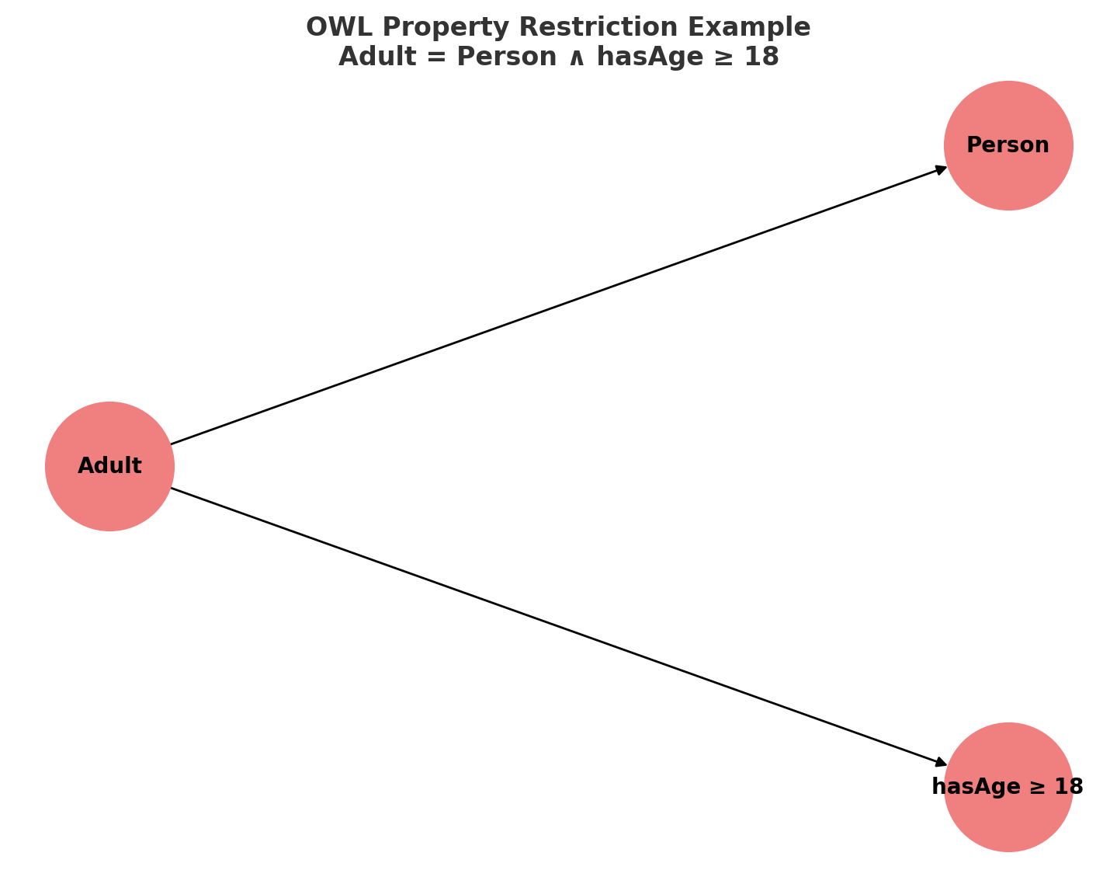
Explanation:
Adult is defined as a subclass of Person with an additional restriction:
The property hasAge must have a value greater than or equal to 18.
In OWL:
Class: Adult EquivalentTo: Person and (hasAge ≥ 18)
Meaning:
If an individual is a Person and their hasAge value is 18 or more,
then the system can automatically classify them as an Adult.

Slide 38
Modeling and Aggregating Social Network Data
Introduction
Social networks (Facebook, Twitter, LinkedIn, etc.) generate huge volumes of structured and unstructured data.
Modeling helps represent this data as graphs for analysis.
Aggregation combines data from different users, groups, or platforms to gain insights.

Slide 39
Modeling Social Network Data
Social network data is usually represented as a graph:
Nodes (Vertices): Represent entities (users, groups, pages).
Edges (Links): Represent relationships (friendship, follow, like, comment).
Attributes: Extra information (age, location, post type, timestamp).
Example Models:
Friendship Graph: Undirected graph showing mutual relationships.
Follower Graph (Twitter): Directed graph (A → B means A follows B).
Interaction Graph: Weighted graph showing frequency of interactions (likes, comments).

Slide 40
Aggregating Social Network Data
Aggregation means combining multiple data points for higher-level analysis.
Types of Aggregation:
User-Level Aggregation
  Combine data of individual users (e.g., total posts, total followers).
Community-Level Aggregation
  Group data based on communities (e.g., political groups, interest groups).
Network-Level Aggregation
  Metrics like average degree, clustering coefficient, modularity.

Slide 41
Key Techniques
Graph Modeling
  Represent social data using graph structures.
Community Detection
  Algorithms like Louvain, Girvan–Newman to identify clusters.
Link Prediction
  Predict future connections using similarity measures.
Information Diffusion Models
  Model how information spreads (e.g., rumors, viral content).
Sentiment & Behavior Aggregation
  Aggregate posts and interactions to analyze emotions, trends, public opinion.

Slide 42
Applications
Marketing: Identify influencers and target audiences.
Epidemiology: Model spread of diseases (COVID contact tracing networks).
Politics: Analyze opinion clusters, misinformation spread.
Recommender Systems: Suggest friends, groups, or content.
Security: Detect fraud, fake accounts, or suspicious communities.

Slide 43
Challenges
Scalability: Handling billions of nodes/edges.
Data Privacy: Protecting user information.
Heterogeneity: Combining structured (graphs) and unstructured (posts, images) data.
Dynamic Nature: Social networks evolve quickly.

Slide 44
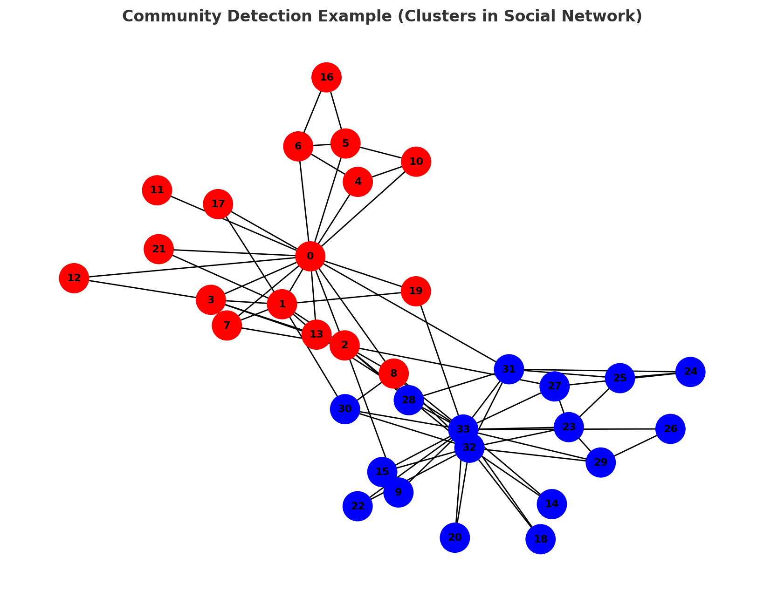
Graphical representation of Community Detection (Clusters)
Explanation:
The graph shown is the Zachary’s Karate Club network, a famous dataset in social network analysis.
Nodes (0–33): Individuals in the network.
Edges: Friendships between individuals.
Colors (Red & Blue): Detected communities (clusters).

Slide 45
How Community Detection Works:
Algorithms (like Girvan–Newman, Louvain, Label Propagation) partition the network.
Members inside the same cluster are more densely connected to each other.
Members in different clusters have fewer connections.

Slide 46
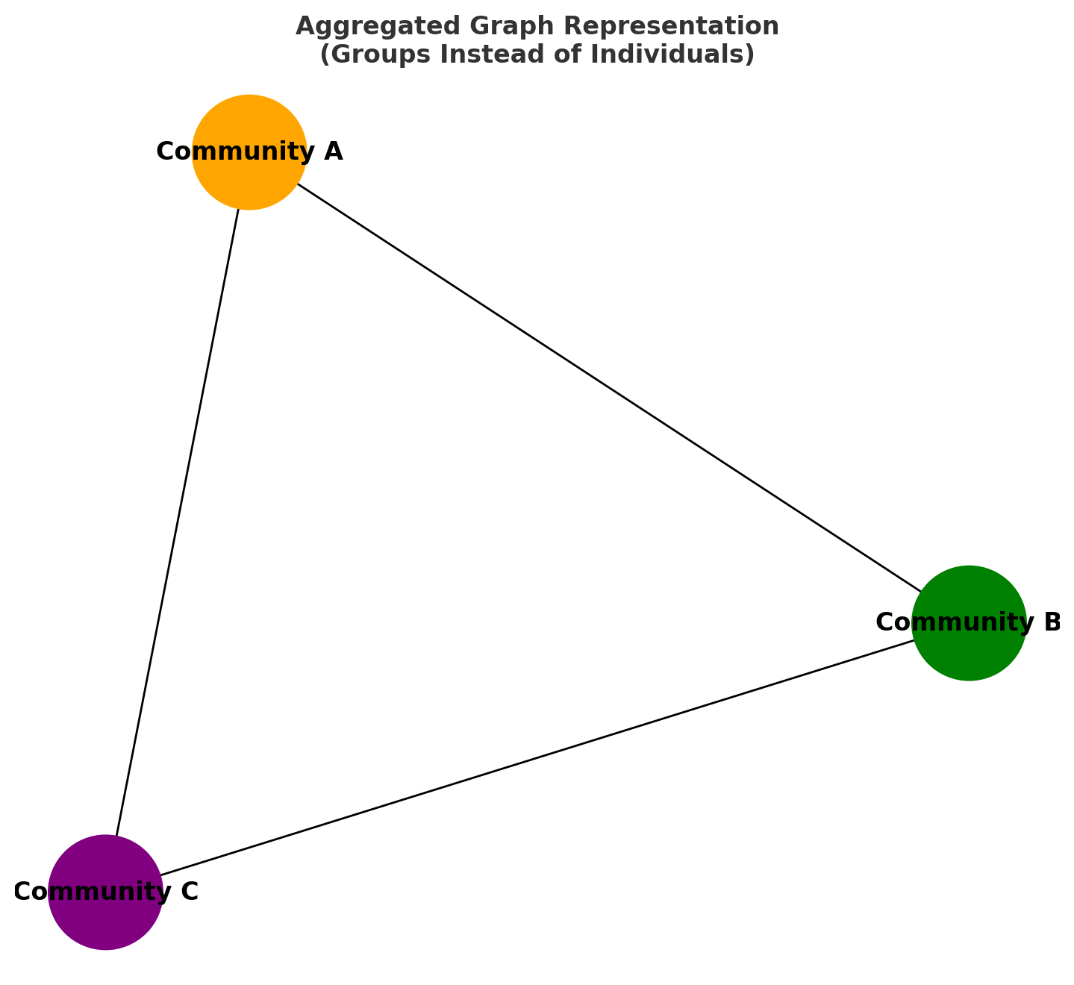
Graphical representation of an Aggregated Graph
Explanation:
Instead of visualizing all individuals (nodes), the network is aggregated into communities (super-nodes).
Community A, B, and C represent groups of individuals (clusters).
Edges represent interactions between groups, not individual members.

Slide 47
Why Aggregation?
Simplifies visualization of large networks.
Makes macro-level relationships between groups clear.
Useful in:
  Marketing → Interaction between customer segments.
  Epidemiology → Disease spread between communities.
  Politics → Influence between voter groups.
  Social Media Analytics → Content flow across online communities.

Slide 48
State-of-the-Art in Network Data Representation
Introduction
Networks (graphs) represent relationships among entities.
Traditional representation = adjacency matrices or edge lists.
State-of-the-art focuses on efficient, scalable, and meaningful representations for modern applications (AI, ML, GNNs).

Slide 49
State-of-the-Art in Network Data Representation(Cont.,)
Traditional Network Representation
Adjacency Matrix
  Matrix representation of nodes and edges.
  Inefficient for sparse networks.
Adjacency List
  Stores neighbors for each node.
  More memory-efficient than matrices.

Slide 50
State-of-the-Art Representations
Graph Embeddings
Maps nodes, edges, or entire graphs into low-dimensional vector spaces.
Preserves structural properties.
Examples:
  DeepWalk (random walks + word2vec)
  Node2Vec (biased random walks)
  LINE (large-scale network embedding)

Slide 51
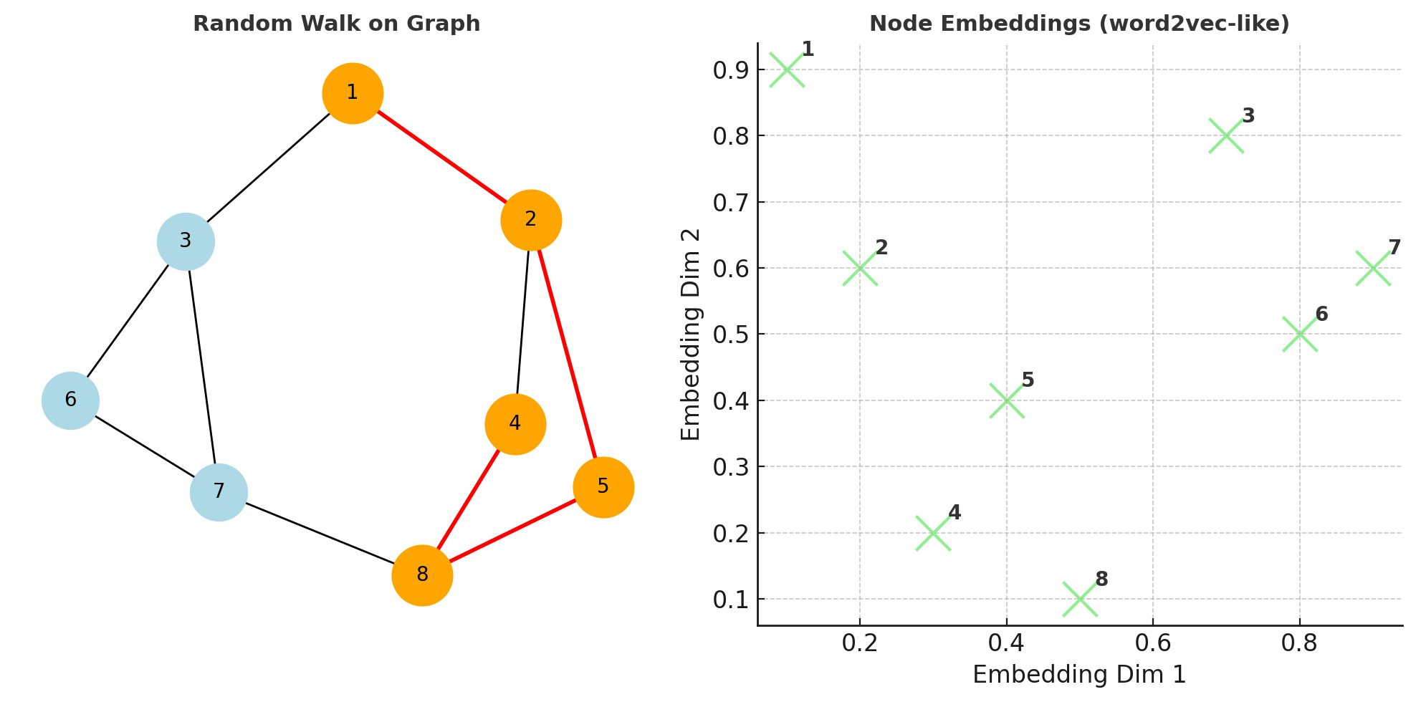
Graphical representation of DeepWalk (Random Walks + word2vec)

Slide 52
Explanations
Left:Random Walk on Graph
A small graph is shown where a random walk (highlighted in red/orange) starts at node 1 and traverses nodes 2 → 5 → 8 → 4.
DeepWalk generates many such random walks across the network.
These walks create sequences of nodes, similar to sentences in natural language.
Right: Node Embeddings (word2vec-like)
The random walk sequences are fed into word2vec, treating nodes as “words.”
Each node is embedded into a low-dimensional vector space.
Similar nodes (that co-occur often in walks) end up closer in embedding space.
Example: Nodes 5 and 8 may have similar embeddings because they frequently co-occur in walks.

Slide 53
DeepWalk = Graph + Random Walks + word2vec
Steps:
Perform random walks on graph.
Generate node sequences.
Apply word2vec (Skip-gram/CBOW) to learn embeddings.
Benefit: Preserves both local and global structure of the network.
DeepWalk is widely used for community detection, link prediction, and social network analysis.

Slide 54
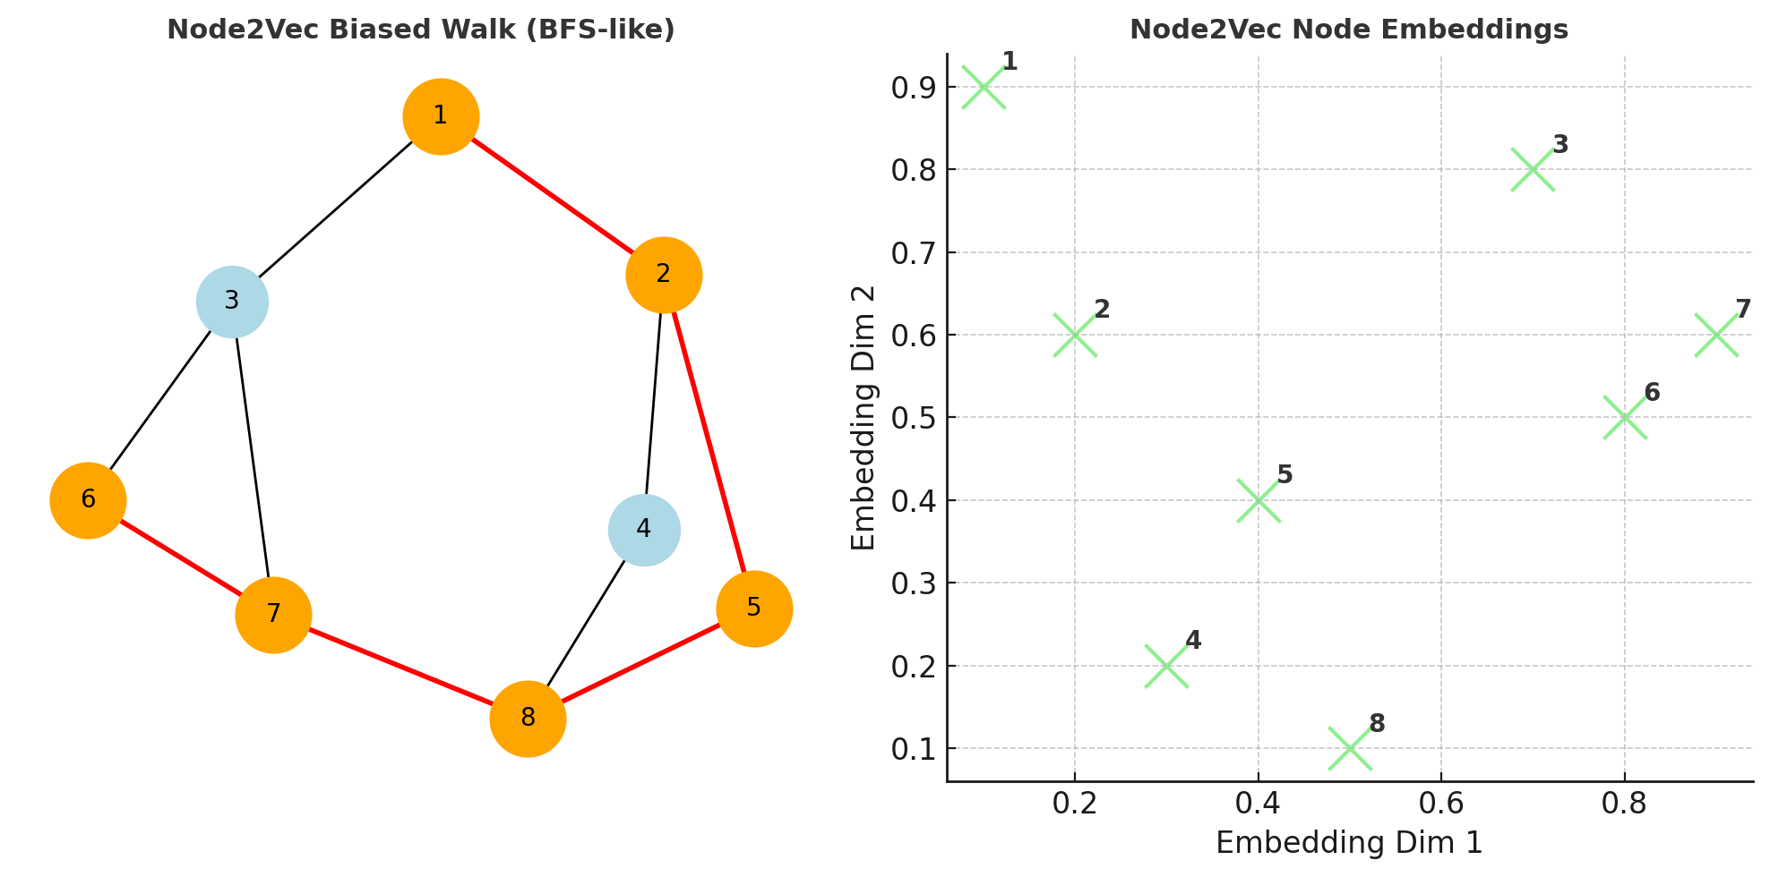
Graphical representation of Node2Vec

Slide 55
Explanation
Left: Biased Random Walk (BFS-like example)
Node2Vec extends DeepWalk by introducing two parameters:
  p (return parameter): Controls likelihood of revisiting a node.
  q (in-out parameter): Controls whether the walk is BFS-like (local neighborhood) or DFS-like (exploring far nodes).
In this example, the walk is BFS-biased, meaning it explores closer neighbors first.
Right: Node2Vec Embeddings
Just like DeepWalk, the biased walks are fed into word2vec.
But because of the bias (p, q), the embeddings capture either:
  Homophily (BFS): Similar nodes close in the same cluster.
  Structural Equivalence (DFS): Nodes with similar roles (e.g., hubs, bridges).

Slide 56
Key Difference from DeepWalk:
DeepWalk: Purely random walks.
Node2Vec: Biased random walks (tunable).
This flexibility makes Node2Vec more powerful for different types of networks.
Node2Vec is widely used in link prediction, recommender systems, fraud detection, and social network analysis.

Slide 57
Graph Neural Networks (GNNs)
Deep learning models designed for graph-structured data.
Iteratively update node representations using neighbor information.
Examples:
  GCN (Graph Convolutional Network)
  GAT (Graph Attention Network)
  GraphSAGE

Slide 58
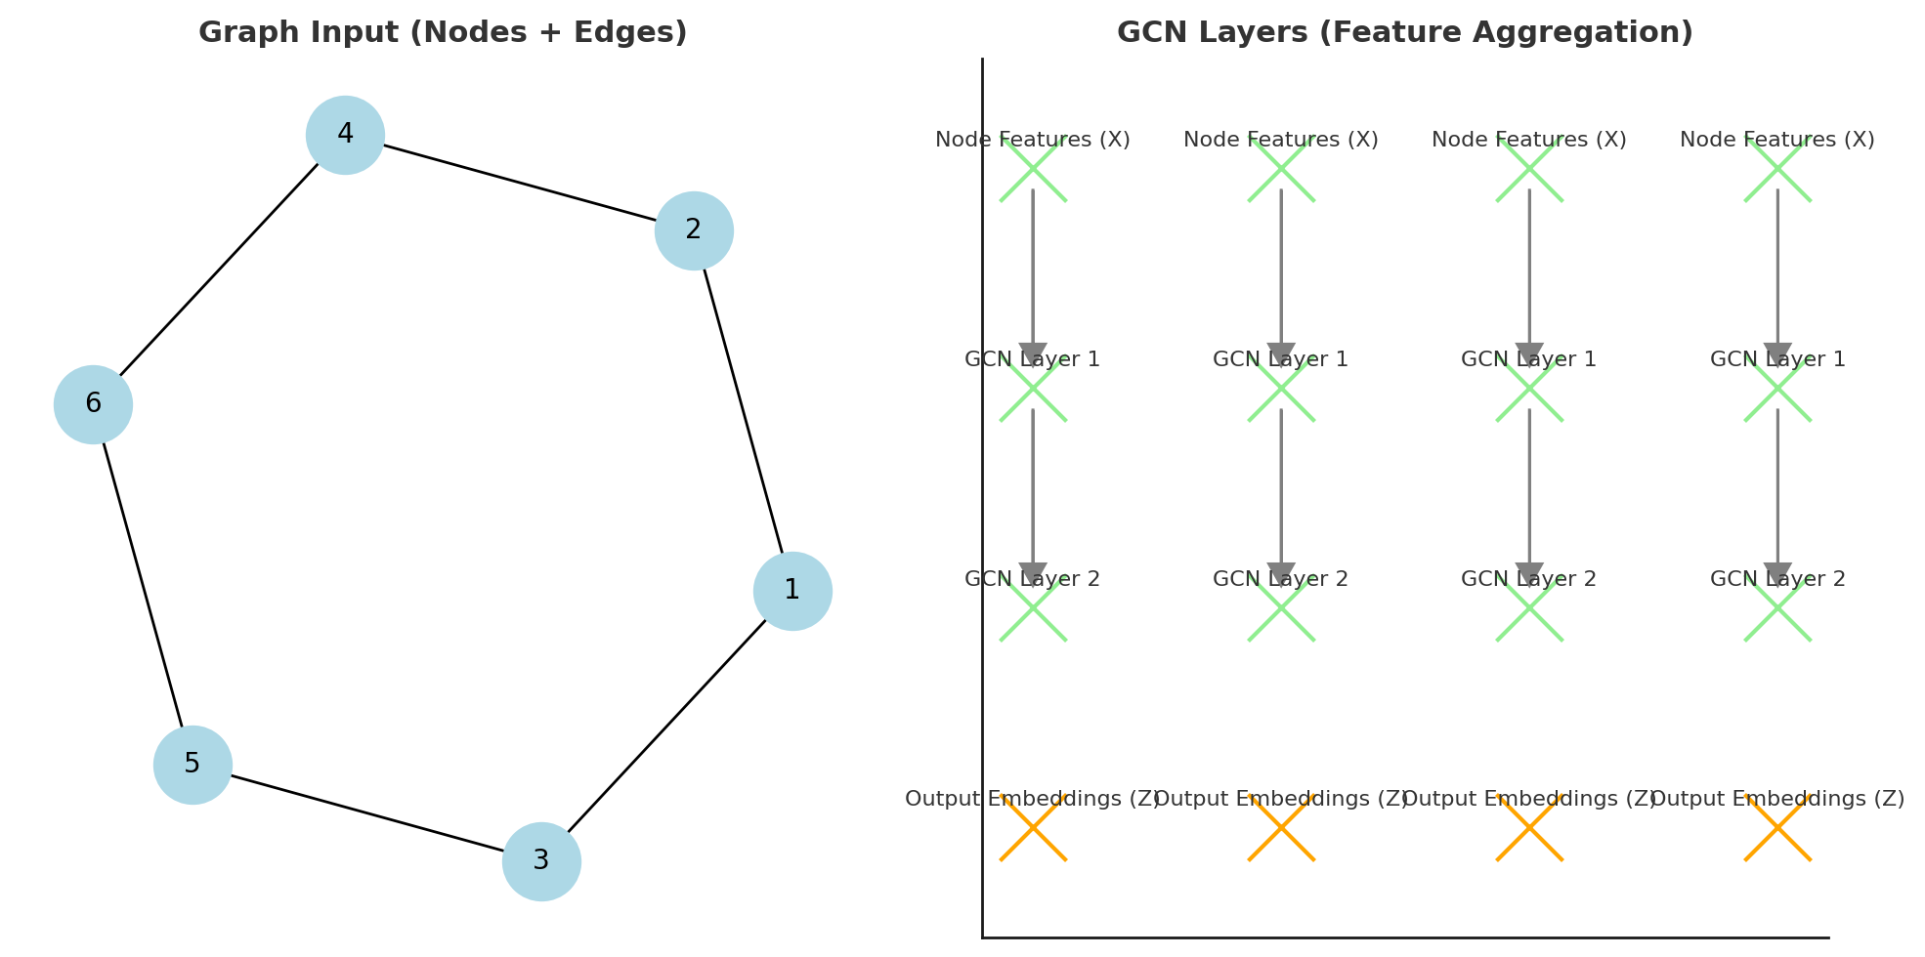
Graph Convolutional Network (GCN)

Slide 59
Explanation
Left: Graph Input
A simple graph structure with nodes (1–6) and edges.
Each node has features (e.g., profile info, attributes).
Right: GCN Layers (Feature Aggregation)
Node Features (X): Input layer where each node has its initial attributes.
GCN Layer 1: Aggregates features from neighbors.
GCN Layer 2: Aggregates again, capturing more global context.
Output Embeddings (Z): Final low-dimensional representation of each node.

Slide 60
How GCN Works
Each node updates its representation by combining its own features with those of its neighbors.
This is like a convolution, but on graphs instead of grids (images).
After multiple layers, nodes learn embeddings that capture both local neighborhood information and global graph structure.
Applications of GCN
Node Classification: Predict labels (e.g., fake vs real accounts in social networks).
Link Prediction: Predict missing edges (e.g., recommend friends on Facebook).
Graph Classification: Identify molecular structures in bioinformatics.
Recommender Systems: Suggest items based on user-item graphs.
In short: GCNs = feature aggregation from neighbors → powerful node embeddings → downstream AI tasks.

Slide 61
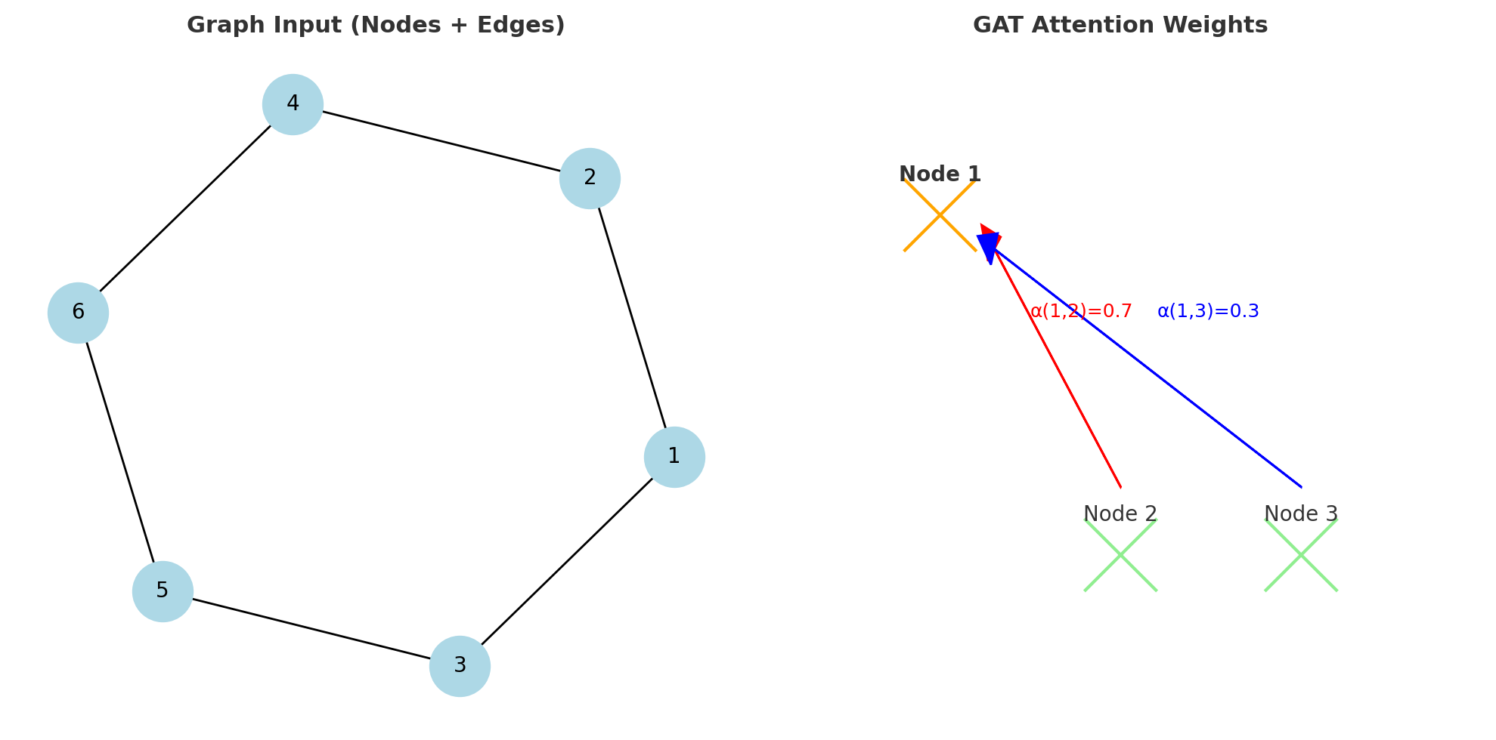
Graph Attention Network (GAT)

Slide 62
Graph Attention Network (GAT)(Cont.,)
Left: Graph Input
A simple graph with nodes and edges.
Similar to GCN, each node has features.
Right: Attention Mechanism
Unlike GCN (which equally aggregates neighbors), GAT assigns weights (attention scores) to neighbors.
Example: For Node 1:
  Attention to Node 2 → α(1,2) = 0.7 (stronger influence)
  Attention to Node 3 → α(1,3) = 0.3 (weaker influence)

Slide 63
How GAT Works
Each node computes attention coefficients with its neighbors.
Coefficients are normalized (using softmax).
Node updates its representation as a weighted sum of neighbors’ features.
This allows the network to focus on the most relevant neighbors.

Slide 64
Benefits of GAT
Learns importance of connections instead of treating all neighbors equally.
Handles heterogeneous graphs better.
Improves performance in tasks like node classification, link prediction, recommender systems.

Slide 65
State-of-the-Art Representations(Cont.,)
Knowledge Graph Representations
Semantic networks with entities and relationships.
Represented in RDF, OWL, or embedding models (e.g., TransE, RotatE).
Used in search engines, question answering, recommender systems.
Dynamic Network Representation
Captures temporal changes in networks.
Example: Social media interactions over time, evolving collaboration networks.
Models: Dynamic embeddings, Temporal GNNs.
Heterogeneous Network Representation
Networks with multiple types of nodes/edges (e.g., user–movie–rating).
Meta-path-based embeddings and heterogeneous GNNs.

Slide 66
Applications
Social Network Analysis (influencer detection, community detection).
Recommender Systems (Netflix, Amazon).
Bioinformatics (protein–protein interaction networks).
Cybersecurity (anomaly detection, fraud detection).
Knowledge Graphs (Google Knowledge Graph, Wikidata).

Slide 67
Advanced Representations & Case Examples
Introduction
Traditional graph representations (adjacency list/matrix) are limited.
Advanced representations capture semantics, dynamics, and heterogeneous relationships.
Widely applied in social networks, healthcare, bioinformatics, recommender systems, and cybersecurity.
Advanced Network Representations
Graph Embeddings
Converts nodes/edges/graphs into low-dimensional vectors.
Preserves structural properties and similarities.
Methods:
  DeepWalk – Random walks + word2vec.
  Node2Vec – Biased random walks (BFS/DFS balance).
  LINE – Large-scale information networks.
  Graph2Vec – Whole-graph embeddings.

Slide 68
Cont.,
Graph Neural Networks (GNNs)
Deep learning models that work directly on graph structures.
Learn embeddings by aggregating information from neighbors.
Examples:
  GCN (Graph Convolutional Network) – Uniform neighbor aggregation.
  GAT (Graph Attention Network) – Attention-weighted aggregation.
  GraphSAGE – Inductive learning using sampling.
Dynamic Graph Representations
Real-world networks evolve over time.
Dynamic embeddings or temporal GNNs capture changes.
Example: Tracking evolving communities on Twitter during elections.

Slide 69
Case Examples
🏥 Healthcare
Ontologies (SNOMED CT, UMLS) + GNNs for patient-disease-symptom networks.
Case: Predicting disease progression using patient similarity graphs.
🌐 Social Networks
DeepWalk/Node2Vec for influencer detection.
Case: Twitter influencer graphs, misinformation detection.
🎬 Recommender Systems
GraphSAGE + heterogeneous networks for personalized recommendations.
Case: Netflix recommending movies based on user–movie–genre embeddings.
🧬 Bioinformatics
GCN applied to protein–protein interaction networks.
Case: Discovering drug–disease associations.
🔒 Cybersecurity
Dynamic graph embeddings for anomaly detection.
Case: Detecting fraudulent transactions in financial networks.

Slide 70
Challenges
Scalability: Billion-node networks.
Dynamic nature: Evolving graphs require real-time updates.
Interpretability: Understanding black-box embeddings.
Heterogeneity: Multiple data types complicate modeling.

